Slide 1

Microprocessor & Computer Architecture (μpCA)
UE19CS252
V R BADRI PRASAD
Department of
Computer Science and Engineering

Slide 2
I/O and Bus Architecture
V R BADRI PRASAD
Department of
Computer Science and Engineering

Slide 3

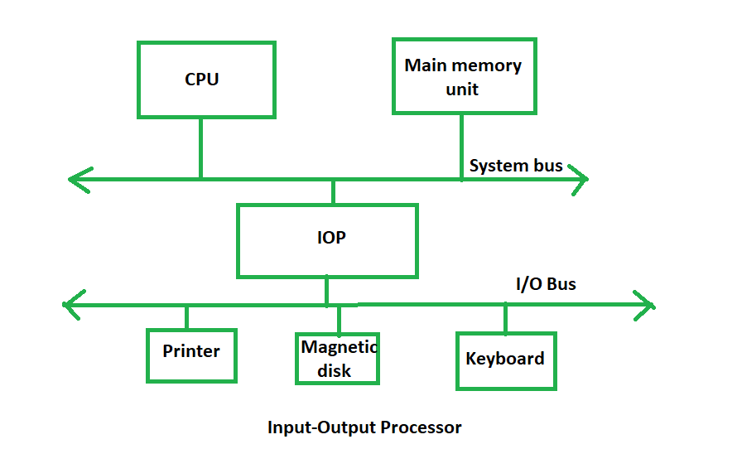
Accessing I/O Devices - Introduction
The method that is used to transfer information between internal storage
and external I/O devices is known as I/O interface.
A typical link between the processor , memory and several peripherals.
These devices work at varying speeds.
Ex: Monitors, Mouse, Keyboards, Video cameras, etc.,
Data transfer rate can either be regular or irregular.

Slide 4
Input/Output
CPU
Cache
Bus
Memory
Disk
Network
USB
DVD
…

Slide 5
I/O Hierarchy
CPU
Cache
Disk
Memory Bus
Memory
I/O
Controller
I/O Bus
Network
USB
DVD
…

Slide 6
Intel Example
P4
Processor
System bus 800 MHz, 604 GB/sec
Memory
Controller
Hub
(North Bridge)
Graphics output
Main
Memory
2.1 GB/sec
DDR 400
3.2 GB/sec
1 Gb Ethernet
266 MB/sec
266 MB/sec
Serial ATA
150 MB/s
I/O
Controller
Hub
(South Bridge)
CD/DVD
Disk
100 MB/s
Tape
100 MB/s
USB 2.0
60 MB/s

Slide 7
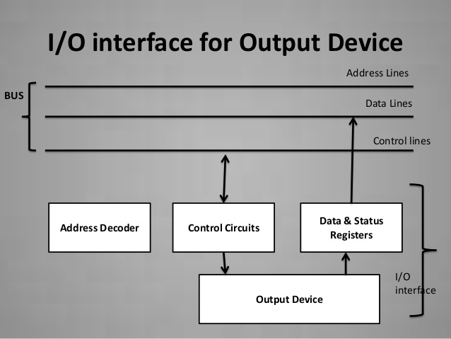
Accessing I/O Devices - Introduction
There exists special hardware components between CPU and peripherals
to supervise and synchronize all the input and output transfers that are
called interface units.
The I/O Bus consists of data lines, address lines and control lines.
The I/O bus from the processor is attached to all peripherals interface.
To communicate with a particular device, the processor places a device
address on address lines.

Slide 8
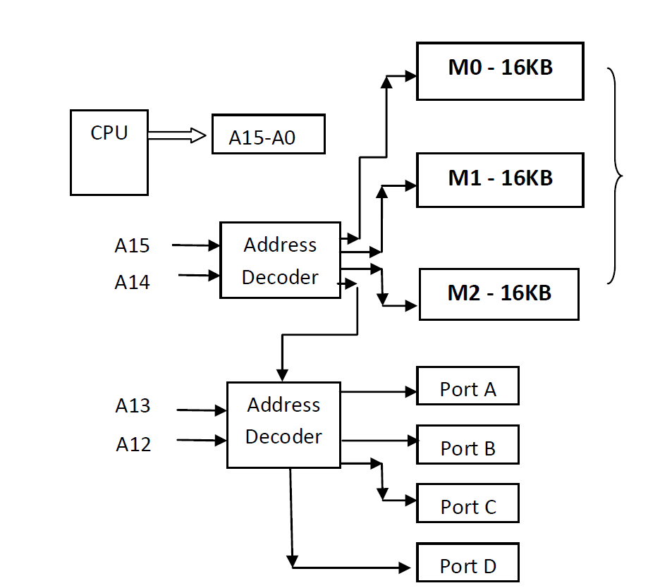
Accessing I/O Devices :
Memory Mapped device interface
Memory Mapped I/O device interface:
Same address decoder selects memory and I/O ports.
Some memory address space is occupied by the I/O devices.
All data transfer instructions to / from memory an be used to
transfer to/from I/O devices.
Processor need not have separate instructions for I/O.

Slide 9
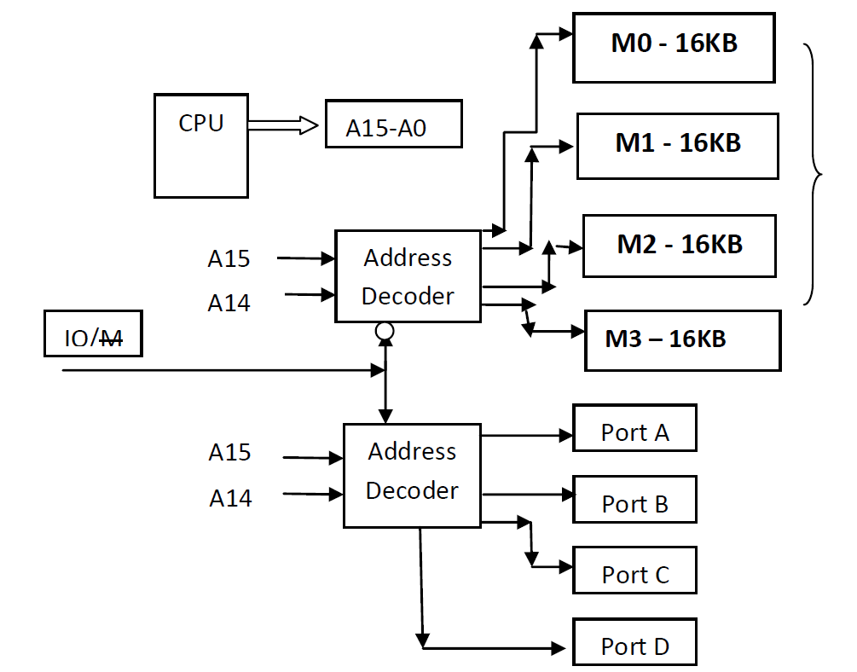
Accessing I/O Devices :
I/O Mapped device interface
I/O Mapped I/O device interface:
Separate instructions for I/O data transfer [ IN / OUT].
Processor signal identifies whether a generated address refers to
memory or I/O device.
Separate address decoder for selecting memory and I/O ports.
Complete memory address space can be utilized.

Slide 10
Accessing I/O Devices – Data Transfer Techniques
Data transfer to and from the peripherals may be done in
any of these ways:
1. Programmed I/O: CPU executes a program and that transfers data between I/O device and Memory
a. Synchronous : Fixed rate of transfer
b. Asynchronous : Handshaking – polling for sending /
receiving the data
c. Interrupt- Driven :( next slide)
2. Direct memory access( DMA): An external controller directly transfers data between I/O device and Memory without CPU intervention.

Slide 11




What is Interrupt/Exception?
Main ()
{
:
Doing something
(e.g.
browsing)
:
} ring
Phone rings
Can happen anytime
Depends on types of interrupts
Phone rings
_isr() // Interrupt service routine
{
some tasks (e.g. answer
telephone)
} //when finished,
//goes back to main

Slide 12
Accessing I/O Devices – Data Transfer Techniques
Interrupt- Driven:
CPU initiates the data transfer and proceeds to perform some other task.
When I/O module is ready for data transfer, it informs the CPU by activating a signal (Interrupt request).
The CPU suspends the task it was doing, services the request from the device and return back to the task it was doing.
Advantages:
CPU time is not wasted by polling the device
CPU time is required only during the data transfer plus some overheads for transferring and returning the control.

Slide 13
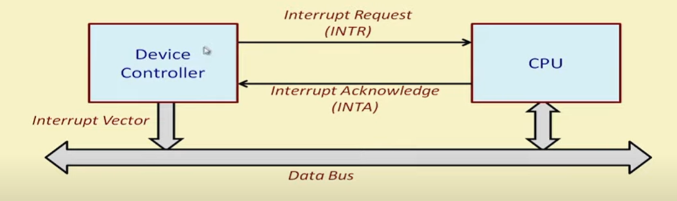
Accessing I/O Devices – Data Transfer Techniques
What happens when an interrupt request arrives?
At the end of the execution of the current instruction, PC and the status register contents are saved in the stack automatically.
Interrupt is acknowledged, interrupt vector is obtained based which the control transfers to the appropriate ISR.
After handling the interrupt, the ISR executes a special instruction return from interrupt(RTI).

Slide 14
Accessing I/O Devices – Data Transfer Techniques
What happens when an interrupt request arrives?
At the end of the execution of the current instruction, PC and the status register contents are saved in the stack automatically.
Interrupt is acknowledged, interrupt vector is obtained based which the control transfers to the appropriate ISR.
After handling the interrupt, the ISR executes a special instruction return from interrupt(RTI).
ARM Interrupt Vector Table

Slide 15
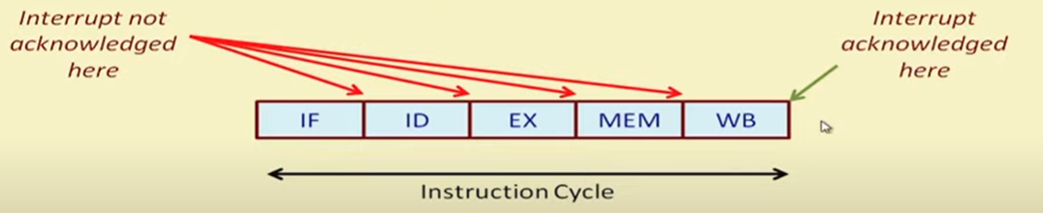
Accessing I/O Devices :
Interrupt request during the execution of an instruction.

Slide 16
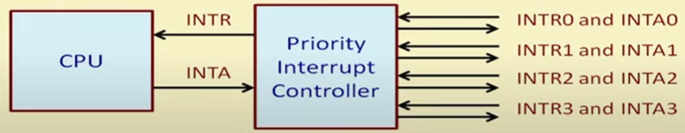
Accessing I/O Devices :
Multiple devices interrupting CPU
Common solution is to use a Priority Interrupt Controller.
Interrupt controller interacts with CPU on one side and multiple devices on the other side.
For simultaneous interrupt requests, interrupt priority is defined.
Interrupt controller is responsible for sending the interrupt vector to the CPU.

Slide 17
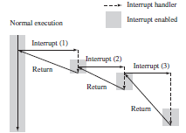
Accessing I/O Devices :
How is interrupt nesting handled?
Consider a scenario.
A device D0 has interrupted and the CPU is servicing the (executing the ISR) device D0.
In the meantime, device D1 has interrupted.
Two possible scenarios are here:
1. D1 will interrupt the ISR for D0, get processed first, and then the ISR for device D0 will be resumed.
This creates problem for multi nesting.
Disable the interrupt system automatically whenever an interrupt is acknowledged.
This will not require nested interrupts to be handled.

Slide 18
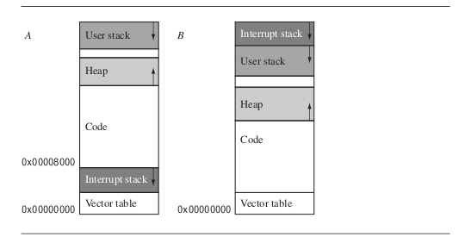
Basic Interrupt Stack Design and Implementation
Stack Layouts

Slide 19
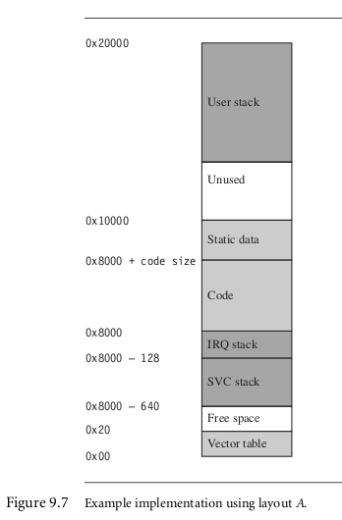
Basic Interrupt Stack Design and Implementation

Slide 20

Interrupt Handling Schemes Non-Nested Interrupt Handler
Various stages in a NNIH –
Enable Interrupts
spsr ← spsr_{interrupt request mode}
pc is restored

Slide 21
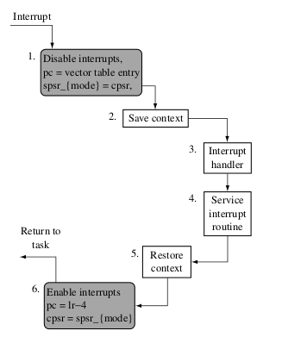
Interrupt Handling Schemes Non-Nested Interrupt Handler

Slide 22
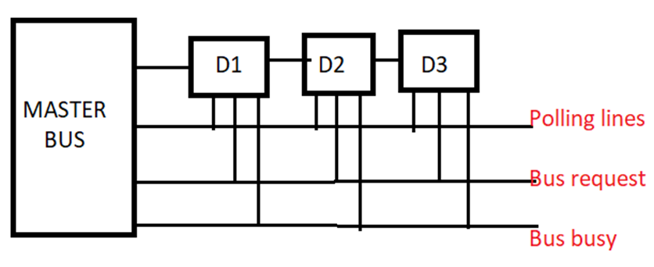
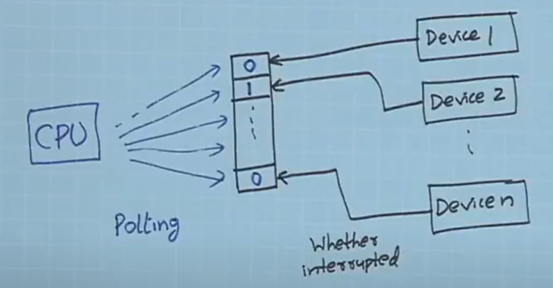
Accessing I/O Devices – Polling Technique
Each device can have a status bit whether the device has interrupted?
CPU can poll the status bit to check for the device which has inetrrupted.

Slide 23
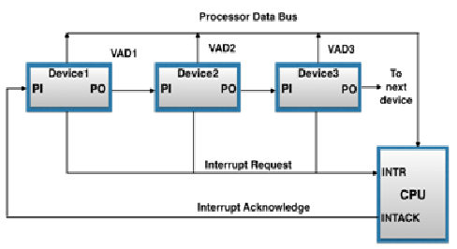
Accessing I/O Devices – Daisy Chain Technique
In Daisy chain technique, INTR line is common to all the devices.
INTA line is connected in a daisy chain fashion [ as shown].
This allows to propagate serially through the devices.
A device when it receives INTA, passes the signal to the next device only if it has not interrupted.
Else, it stops the propagation of INTA and puts the identifying code on the data bus.
Thus the device that is electrically closest to the CPU will have the highest priority.

Slide 24
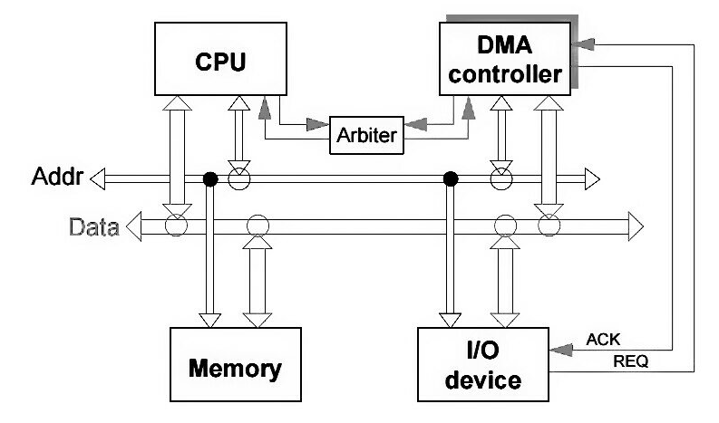
2. Direct Memory Access(DMA) Controller
What is actually DMA?
The direct memory access is a system where the samples are saved in the memory of the system while the processor does something else.
Why we need DMA?
The assumption about the I/O machines like keyboards, mouse, and printer etc. are genuinely very slow when compared with the central processing unit (CPU).
To overcome this issue an interrupt handler was used and the I/O machine produces all the signals that the CPU produce, then the I/O machine can bypass the information alienates to central processing unit and hence increases the speed.

Slide 25
2. Direct Memory Access(DMA) Controller
Cycle Stealing Process: Traditionally it is a method of accessing RAM or bus without interfering with the CPU.
DMA allows I/O controllers to read or write RAM without CPU intervention.
Clever exploitation of specific CPU or bus timings can permit the CPU to run at full speed without any delay if external devices access memory not actively participating in the CPU's current activity and complete the operations before any possible CPU conflict.
Such systems are nearly dual-port RAM without the expense of high speed RAM.
Most systems halt the CPU during the steal, essentially making it a form of DMA by another name

Slide 26
Bus Architectures – next session
Universal Serial Bus
Peripheral Component Interconnect Bus
Small Computer System Interface Bus

Slide 27
Microprocessor & Computer Architecture (μpCA)
Thank You
V R BADRI PRASAD
Department of
Computer Science and Engineering

Slide 28
USB, PCI, SCSI
Bus Architecture
V R BADRI PRASAD
Department of
Computer Science and Engineering

Slide 29
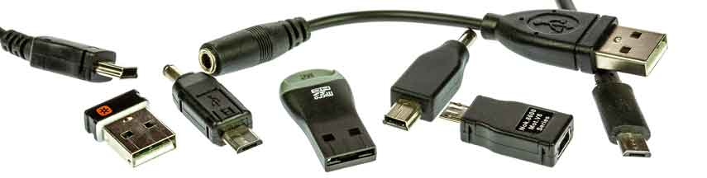
Universal Serial Bus Architecture
Universal Serial Bus is a data interface used with computers
enabling the computer to send and receive data as well as
providing power to some peripherals like disc drives, Flash
memory sticks and the like so that separate power sources are
not needed for each item

Slide 30
Universal Serial Bus Architecture
USB Peripherals are slaves responding to commands from hosts
When a peripheral is attached to the USB network, the host
communicates with the device.
To learn its identity
To discover which device driver is required
This is called Enumeration
It is supported as the device driver for the USB port on the
host.
Power :
USB devices can pull limited amount power from the bus.
Speed:
Low : 1.5Mbps
Full : 12Mbps
High : 480 Mbps

Slide 31
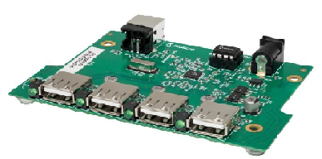
Universal Serial Bus Architecture
USB Devices are of two types.
Stand-alone:
Single Function Units like Mouse,etc.,
Compound Devices:
More than one peripheral sharing a USB port.
Ex: Video Camera (both audio and video ).
USB Hubs:
Hubs are bridge
Themselves are USB devices
Hubs detect topology changes due to insertion and deletion of devices.

Slide 32
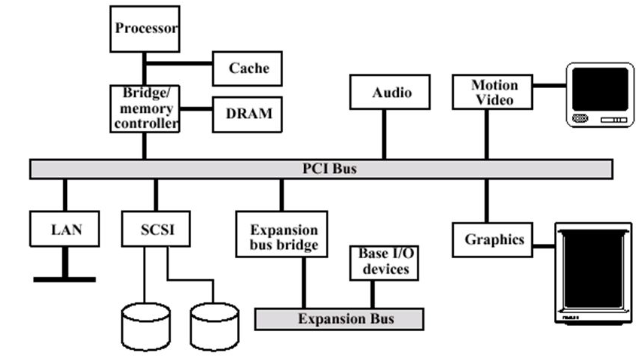
Peripheral Component Interconnect : PCI-Bus Architecture
PCI is a local computer bus for attaching hardware
devices in a computer.

Slide 33
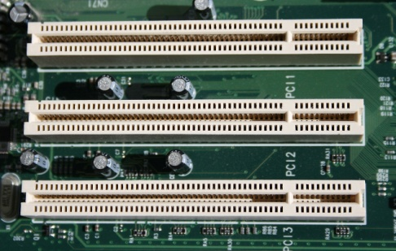
Peripheral Component Interconnect : PCI-Bus Architecture
Features:
32 bit bus
Transfer rate : 133MB/s
Any PCI device may initiate a transaction.
First, it must request permission from a PCI bus arbiter on the
motherboard.
The arbiter grants permission to one of the requesting devices.
The initiator begins the address phase by broadcasting a 32- bit
address plus a 4-bit command code, then waits for a
target to respond.
All other devices examine this address and one of them
responds a few cycles later.

Slide 34
SCSI -Bus Architecture
Small Computer System Interface – SCSI :
Derived from SASI – Shugart Associates System Interface
Provided as a bridge between hard disk low-level interface and a host computer
Standard Interface and communication protocol for connecting computer
peripherals.
SCSI is used to increase performance and deliver faster
Bus can address upto 8 devices (0 to 7).
Provide larger expansion for devices such as CDs, scanners, etc.,
Based on the Client Server Architecture
Clients are Initiators – creates(begins)and sends SCSI commands to the target.
Servers are Targets – Collection of logical units – carries out the requested task.
Early SCSI assumes a bus based architecture

Slide 35
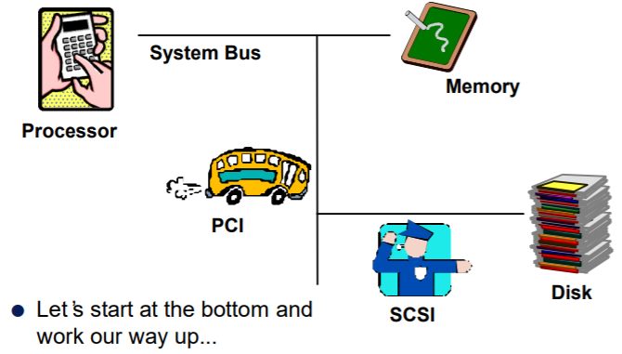
SCSI -Bus Architecture
Small Computer System Interface – SCSI :
Parallel SCSI: SCSI-1 : 8 bit wide bus – speed 3.5MHz
SCSI-2 : 16 /32 bit wide – speed 10MHz to 20MHz
SCSI-3 : Also called as ultra SCSI.
Cable length- 3 mts.
Speed – 20MHz

Slide 36
SCSI -Bus Architecture
SCSI Bus Operation in phases:
Data Command Msg Status
BUS free
Arbitration
Selection
Message
Bus Free
Arbitration
Selection / Reselection : target in control
Target decides when to recv msg, cmd, data from initiator.
OR send status to initiator
Message
Used by target to send / recv protocol information.
Eg : Identify, cmd complete, msg parity error, etc.,
Data, command, message, status

Slide 37
Microprocessor & Computer Architecture (μpCA)
Thank You
V R BADRI PRASAD
Department of
Computer Science and Engineering

Slide 38
AMBA and ASB
Bus Architecture
V R BADRI PRASAD
Department of
Computer Science and Engineering

Slide 39
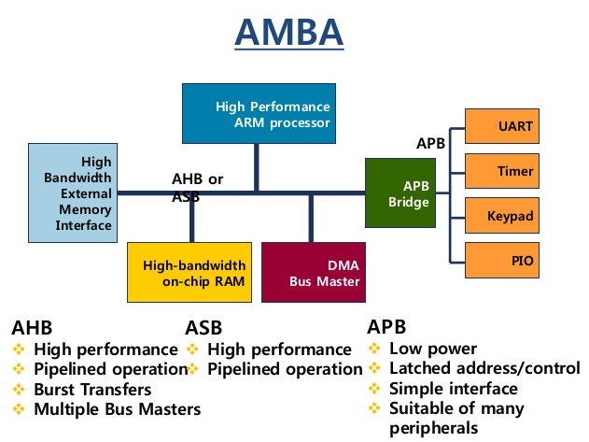
AMBA (Advanced Microprocessor Bus Architecture) protocol
The Arm AMBA protocols are an open standard, on-chip interconnect specification for the connection and management of functional blocks in a System-on-Chip (SoC).
It facilitates right-first-time development of multi-processor designs with large numbers of controllers and peripherals.
Features of AMBA Interfaces:
IP reuse is essential in reducing SoC development costs and timescales. AMBA specifications provide interface standards that enables IP reuse if the following essential requirements are met:
Flexibility:
Wide Adaption:
Compatibility:
Support:

Slide 40
APB (Advanced Peripheral Bus ) protocol
The Advanced Peripheral Bus (APB) is part of the Advanced Microcontroller Bus Architecture (AMBA) protocol family.
It defines a low-cost interface that is optimized for minimal power consumption and reduced interface complexity.
The APB protocol is not pipelined, use it to connect to low-bandwidth peripherals that do not require the high performance of the AXI protocol.
The APB protocol relates a signal transition to the rising edge of the clock, to simplify the integration of APB peripherals into any design flow.
Every transfer takes at least two cycles.
The APB can interface with:
• AMBA Advanced High-performance Bus (AHB)
• AMBA Advanced High-performance Bus Lite (AHB-Lite)
• AMBA Advanced Extensible Interface (AXI)
• AMBA Advanced Extensible Interface Lite (AXI4-Lite)

Slide 41
Microprocessor & Computer Architecture (μpCA)
Thank You
V R BADRI PRASAD
Department of
Computer Science and Engineering

